Slide 1
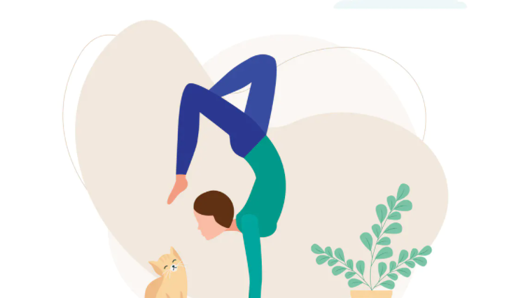
Balancing Bias
12 @ 12

Slide 2
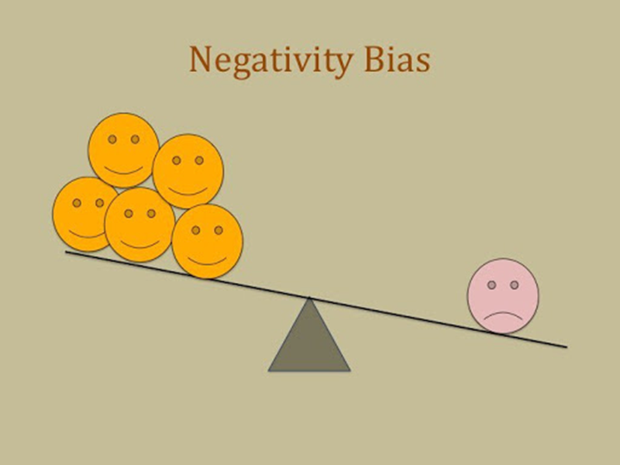
Our Negativity Bias
Bad things can have up to four times more impact on us than good things
Noticed more
Felt more strongly
Last longer
Fast track into our memory banks

Slide 3
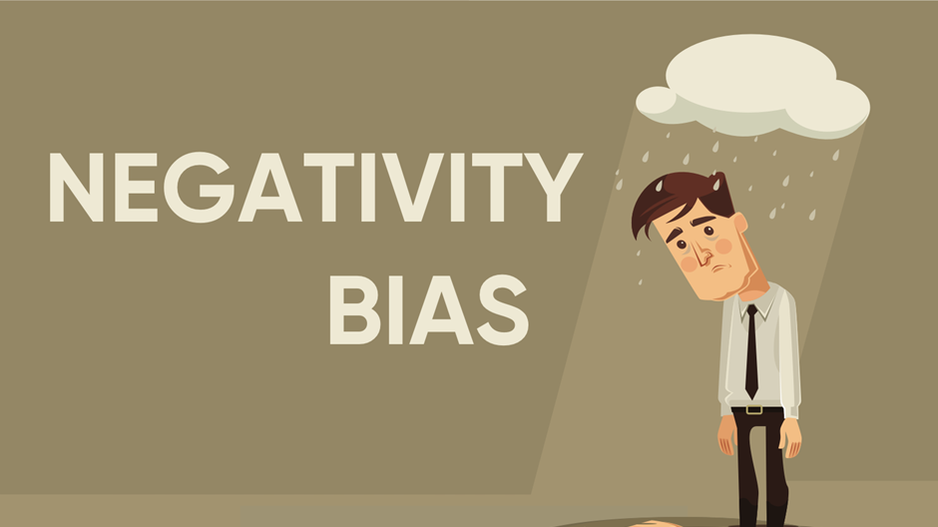

Slide 4
“The mind is like
Velcro for negative experiences
and
Teflon for positive ones.”
Rick Hanson

Slide 5
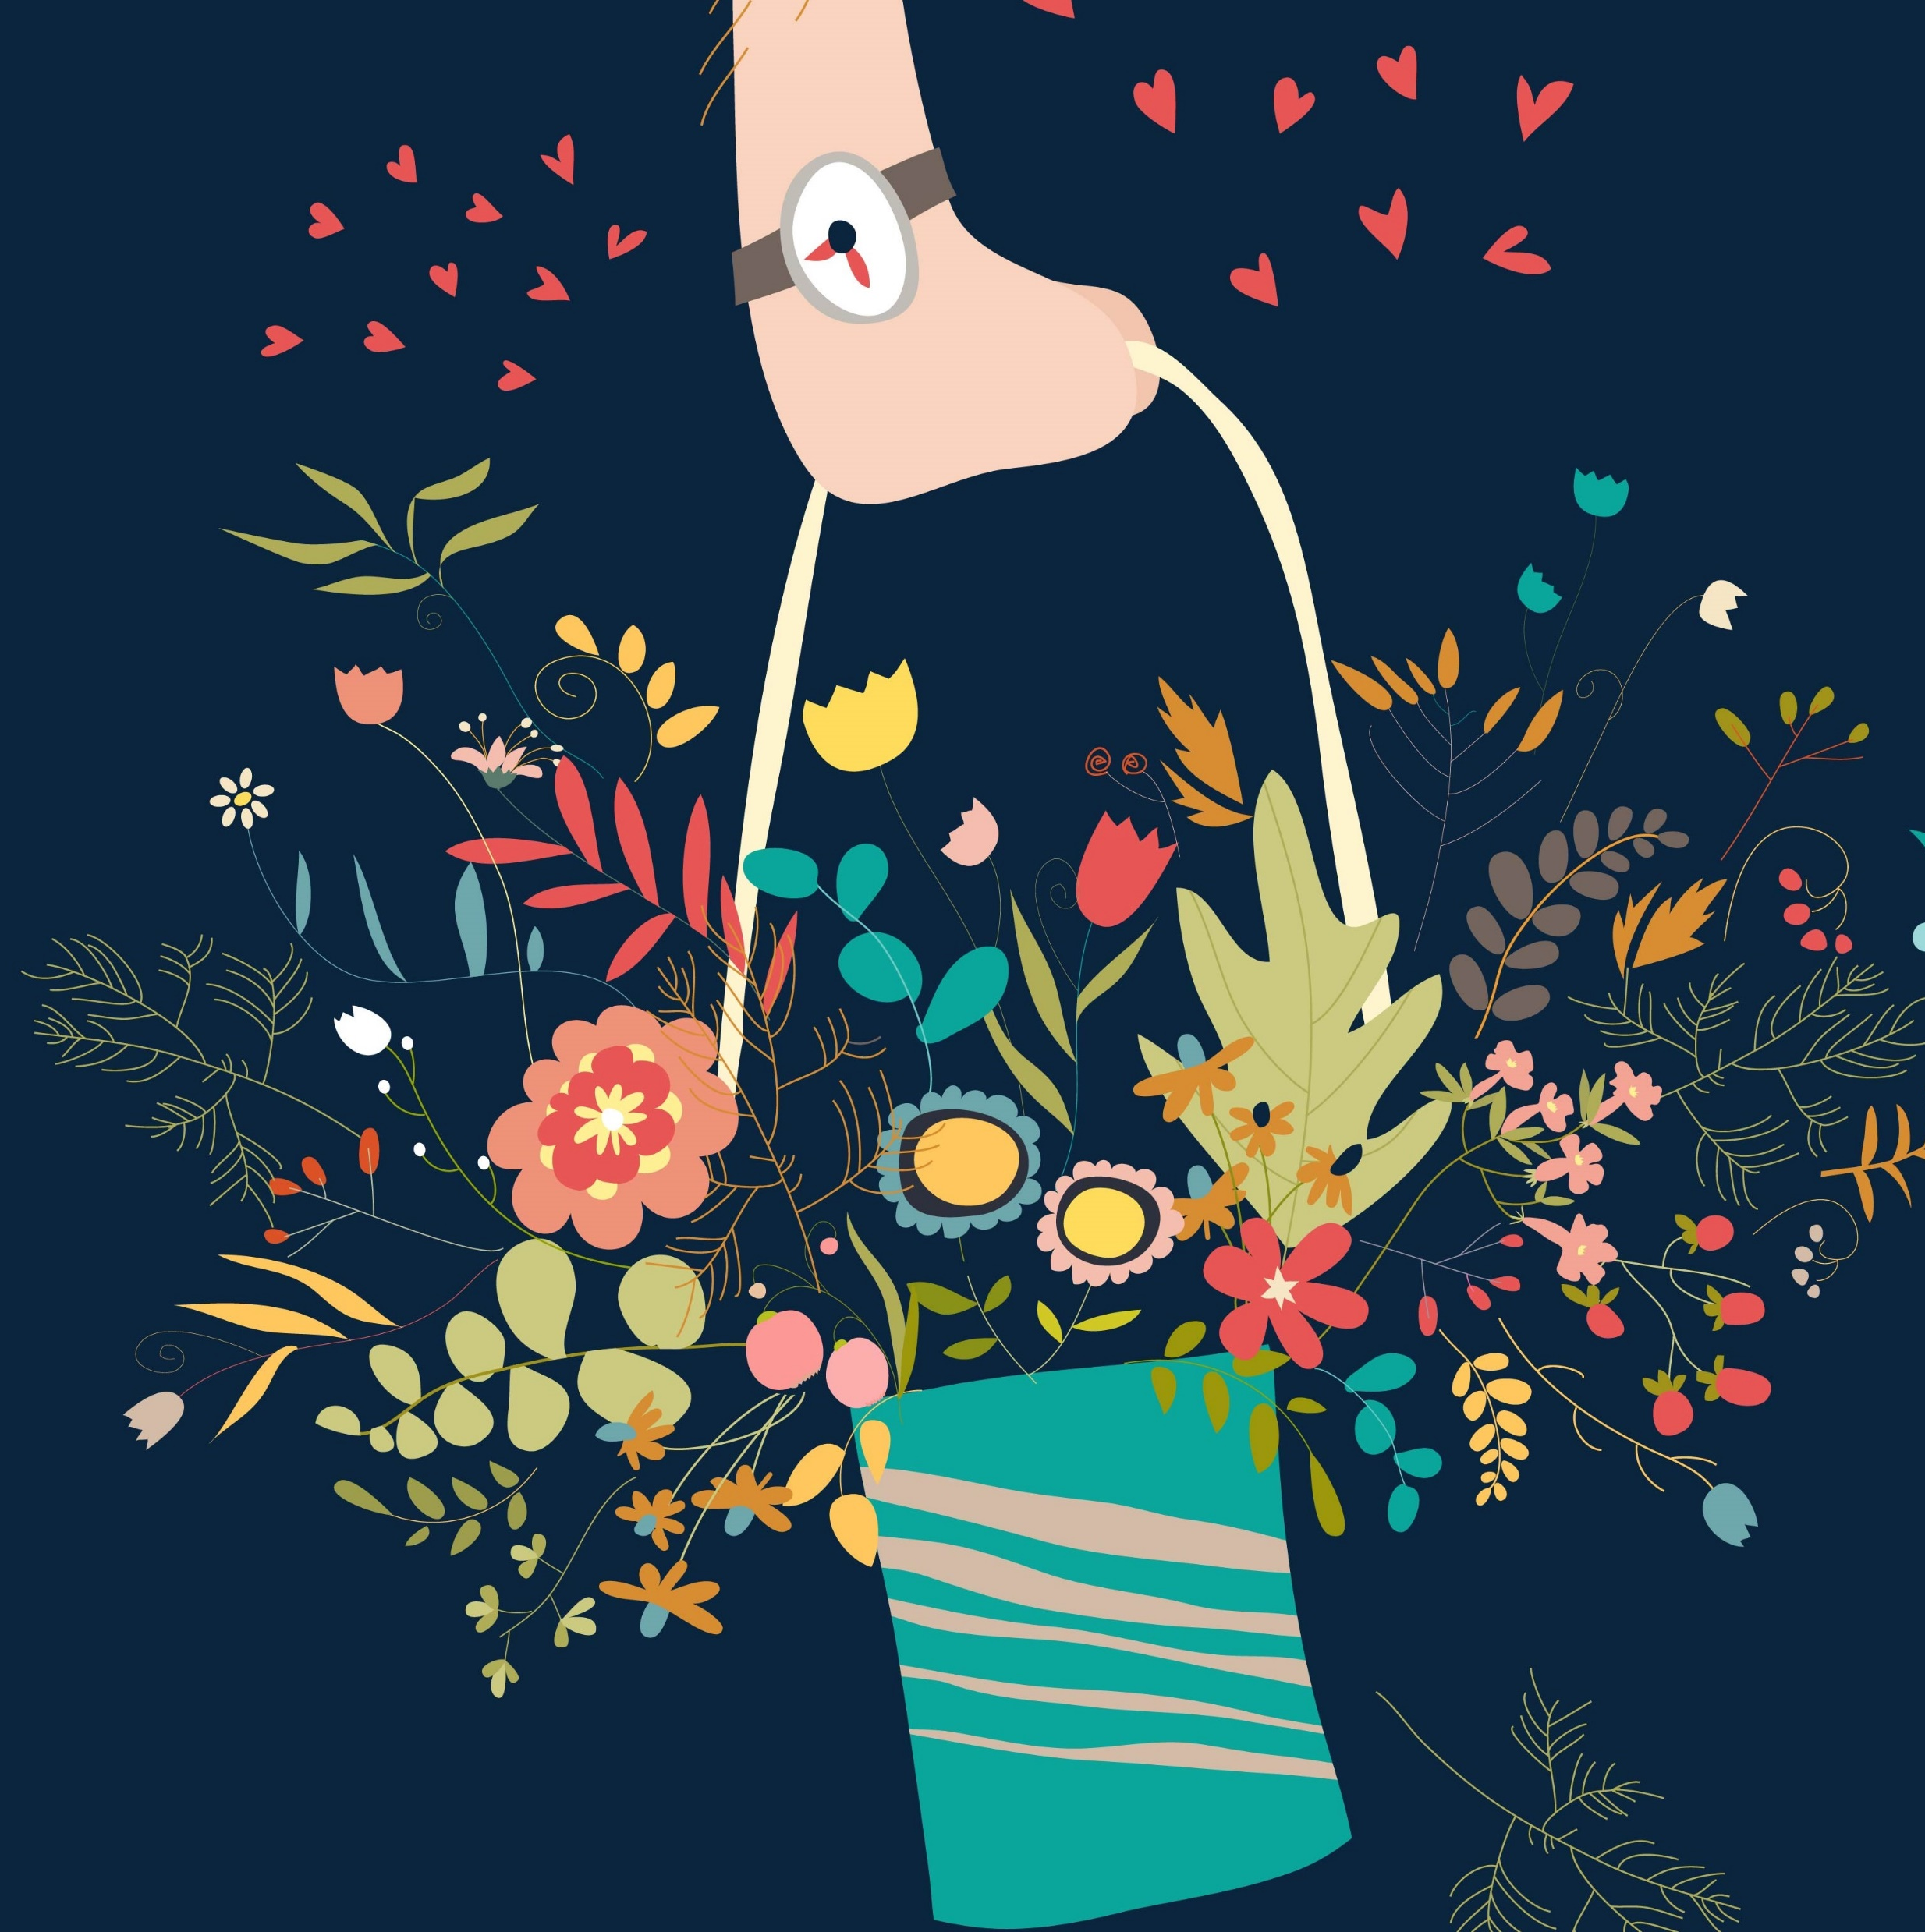
Balance with www
&
Gratitude Practice

Slide 6
What do you do to practice gratitude ?
You
Your team
Your family

Slide 7
You may want to create a Gratitude Practice habit
After
After I stop at red traffic lights.
Behaviour
I think of things that I am grateful for.
Celebrate
Usually I laugh at my traffic light antics.

Slide 8
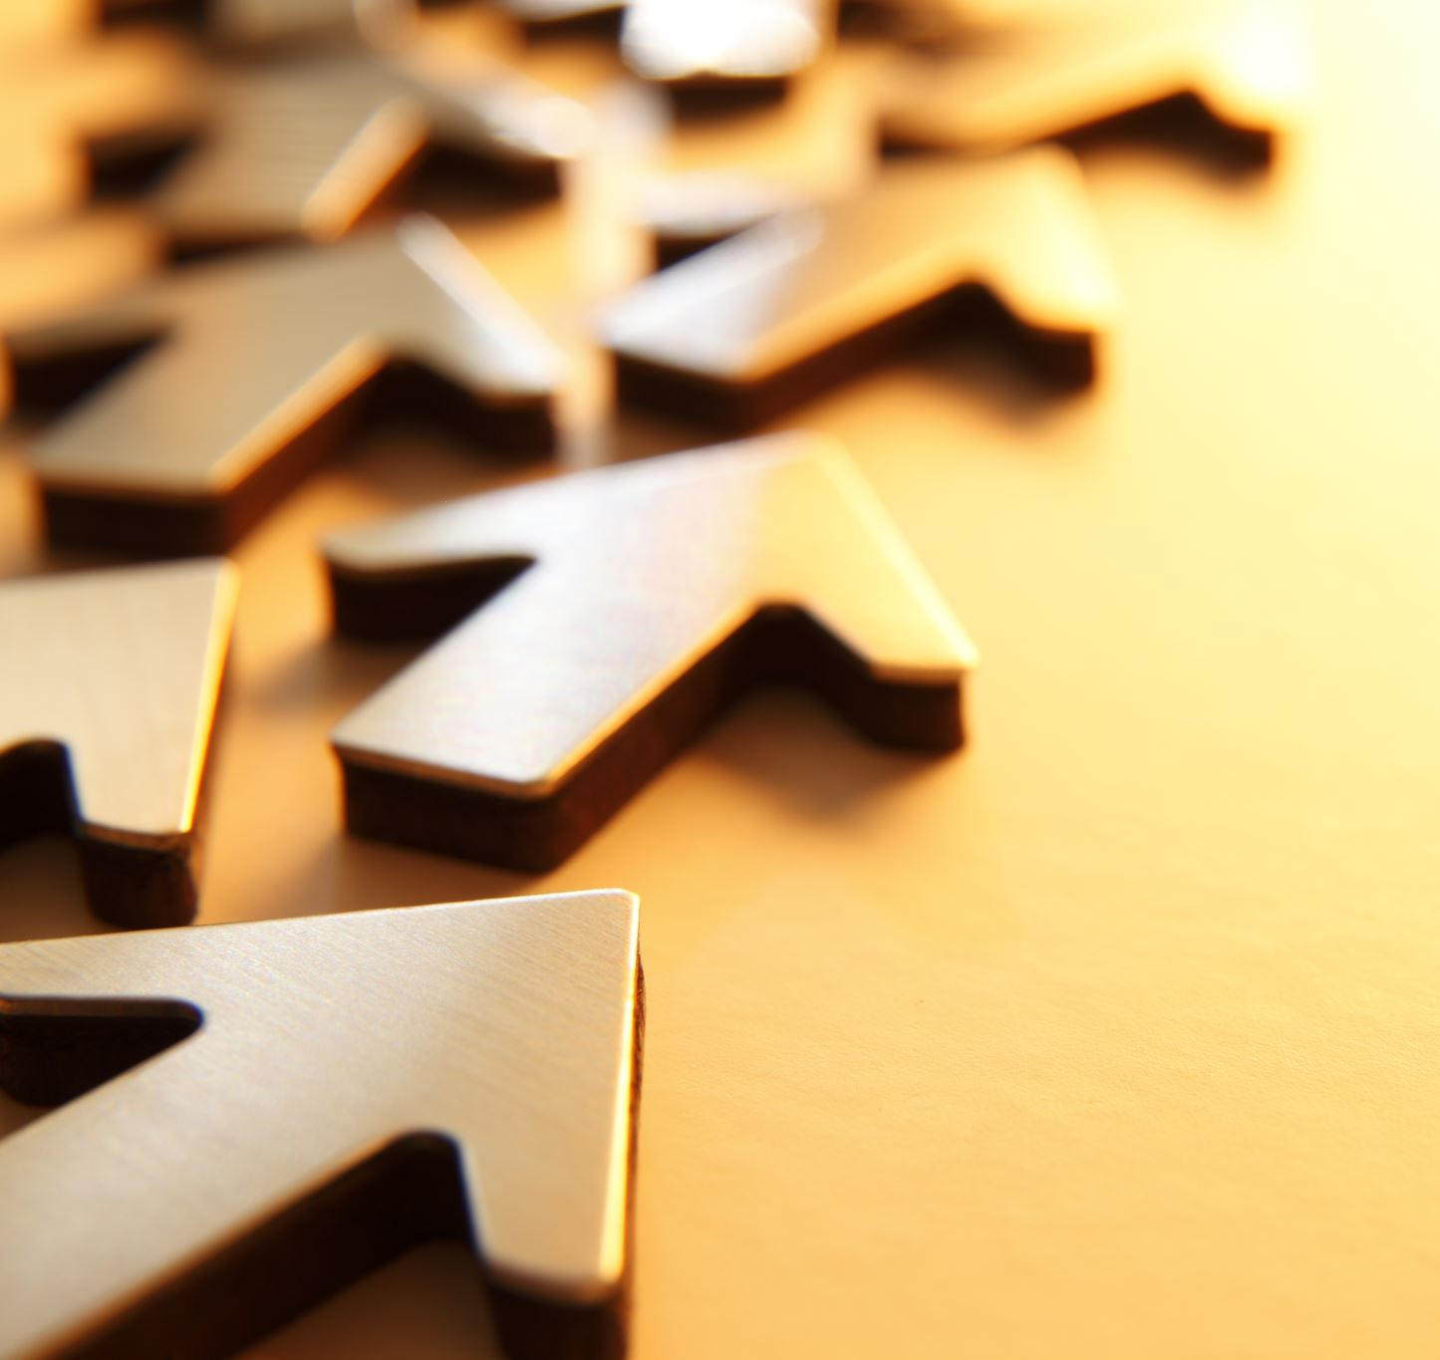
Want to find out more?
Roy Baumeister
Bad Is Stronger Than Good
Robert Emmons
Cultivating Gratitude

